Slide 1
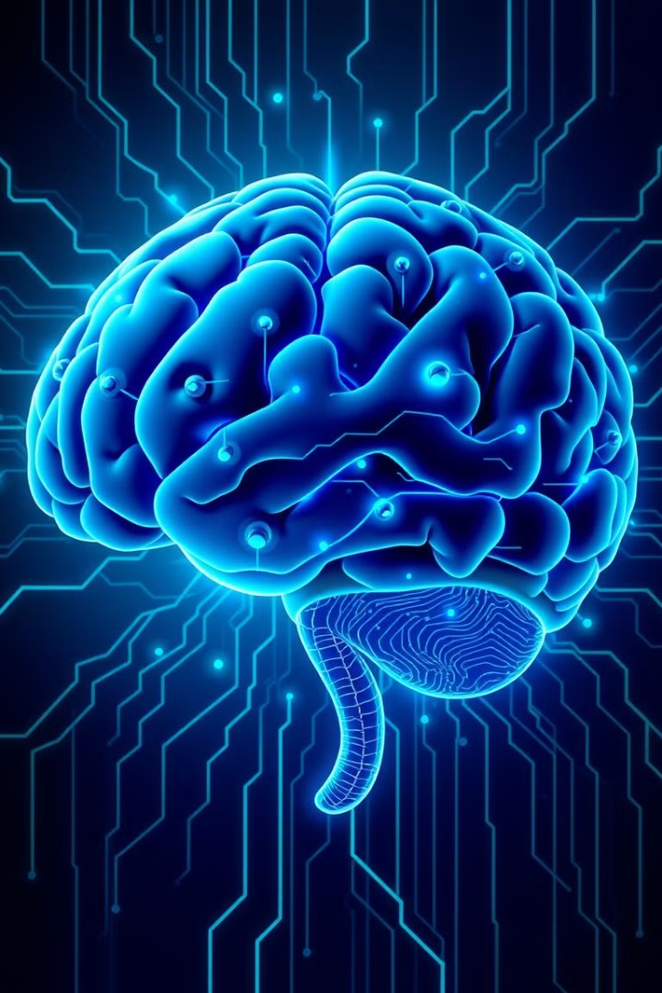

Artificial Intelligence in Healthcare
This presentation explores the transformative potential of AI in healthcare, examining its applications, challenges, and future impact.
by ShaTech jsjk

Slide 2
Transforming the Practice of Medicine
Enhanced Diagnosis
Personalized Treatment
AI algorithms can analyze medical images, detect patterns, and assist in diagnosing diseases earlier and more accurately.
AI helps tailor treatments based on individual patient characteristics and predict treatment outcomes, optimizing patient care.

Slide 3

Addressing Healthcare Challenges
1
Rising Healthcare Costs
2
Physician Burnout
3
Access to Care
AI can optimize resource allocation, reduce unnecessary procedures, and improve efficiency, leading to cost savings.
AI can automate repetitive tasks, freeing up physicians' time to focus on complex patient care and improve well-being.
AI-powered telemedicine and remote patient monitoring can expand access to healthcare services in underserved areas.

Slide 4
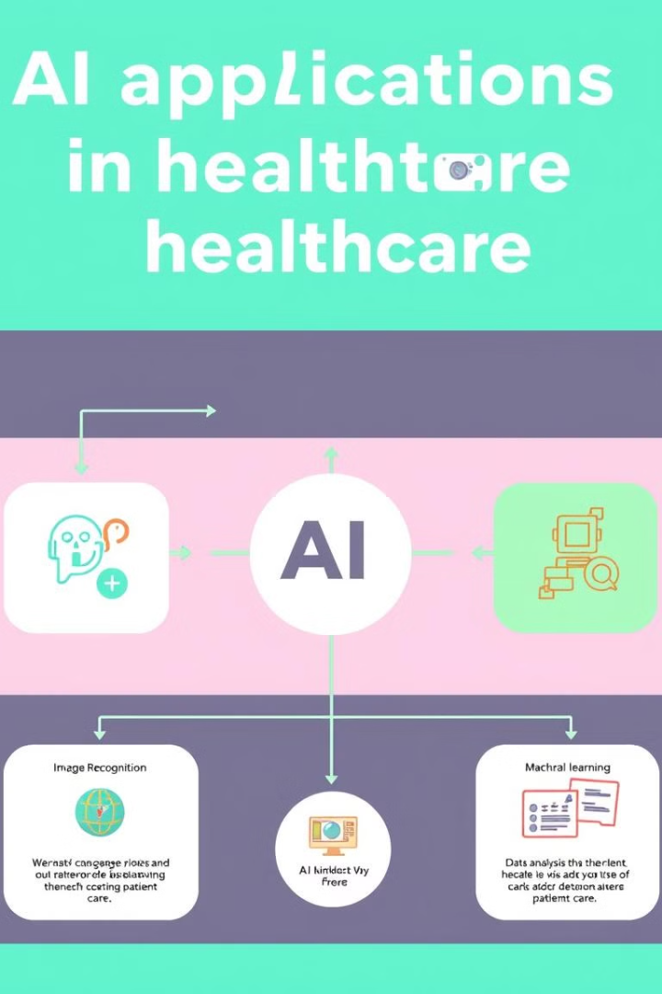
AI Fundamentals and Applications
Machine Learning
Natural Language Processing
Algorithms learn from medical data to predict outcomes, identify patterns, and make decisions.
AI processes and understands patient records, reports, and conversations, facilitating medical documentation and communication.
Computer Vision
AI analyzes medical images, such as X-rays, CT scans, and MRIs, to detect abnormalities and support diagnosis.

Slide 5
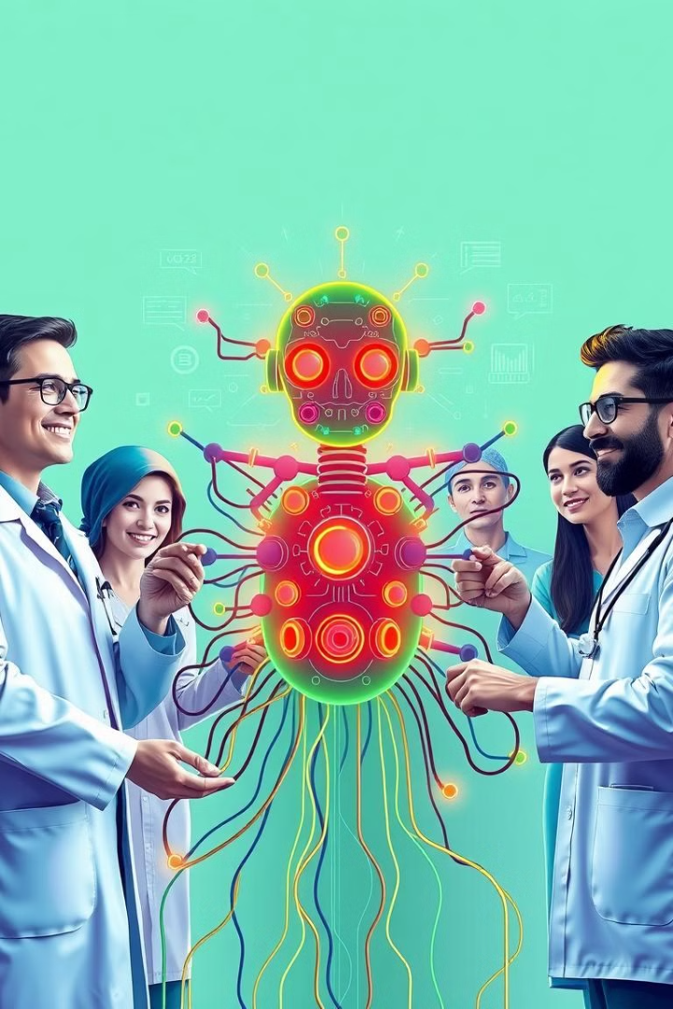



Building Effective AI Systems
Data Quality
Algorithm Selection
High-quality, comprehensive, and unbiased data is crucial for training accurate and reliable AI models.
Choosing the right algorithm based on the specific healthcare task and available data is essential.
Model Training and Validation
Models are trained on large datasets and then rigorously validated to ensure accuracy and performance.

Slide 6
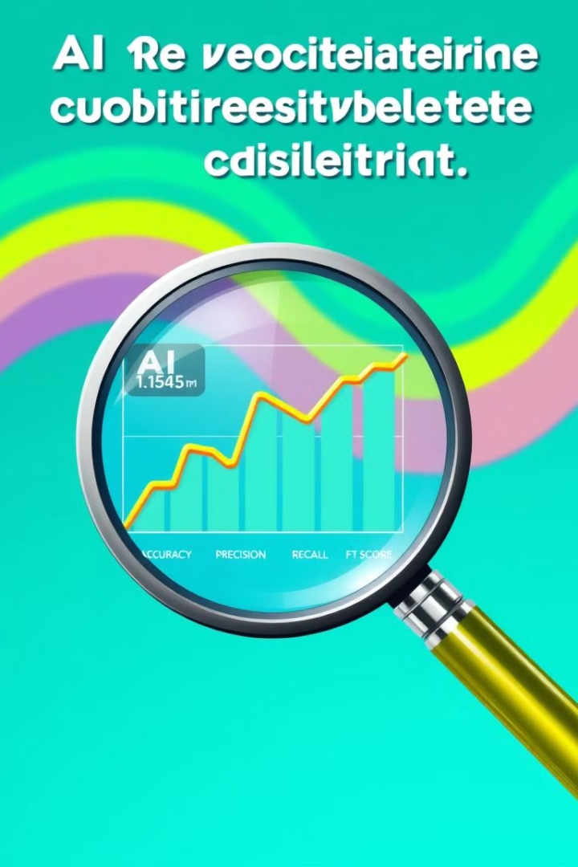
Evaluation and Validation
1
Performance Metrics
Accuracy, precision, recall, and F1-score are essential metrics for evaluating the effectiveness of AI models.
2
Bias Detection
AI models can inherit biases from the training data, requiring careful analysis and mitigation to ensure fairness and equity.
3
Clinical Validation
AI models are tested in real-world clinical settings to ensure their efficacy and safety in patient care.

Slide 7




Scaling and Diffusing AI Solutions
Interoperability
AI solutions must seamlessly integrate with existing healthcare systems to ensure data sharing and information flow.
Regulatory Compliance
AI systems must adhere to regulatory standards and ensure patient privacy and data security.
User Adoption
Healthcare professionals must be trained and equipped to effectively use AI tools and integrate them into their workflows.

Slide 8




Current and Future AI Use Cases
Drug Discovery
1
AI accelerates drug development by identifying potential targets and predicting drug efficacy.
Precision Medicine
2
AI tailors treatments based on individual patient genetic profiles, providing personalized and targeted therapies.
Disease Prediction
3
AI analyzes patient data to identify individuals at risk for developing specific diseases, enabling early intervention.
Virtual Assistants
4
AI chatbots and virtual assistants provide 24/7 support to patients, answering questions and scheduling appointments.

Slide 9
Connected and Augmented Care
Telemedicine
1
AI enables remote consultations, diagnoses, and monitoring, expanding access to care.
Remote Patient Monitoring
2
AI analyzes real-time patient data from wearable devices to identify potential health issues.
Augmented Reality
3
AI-powered augmented reality tools assist surgeons during procedures, improving accuracy and precision.

Slide 10
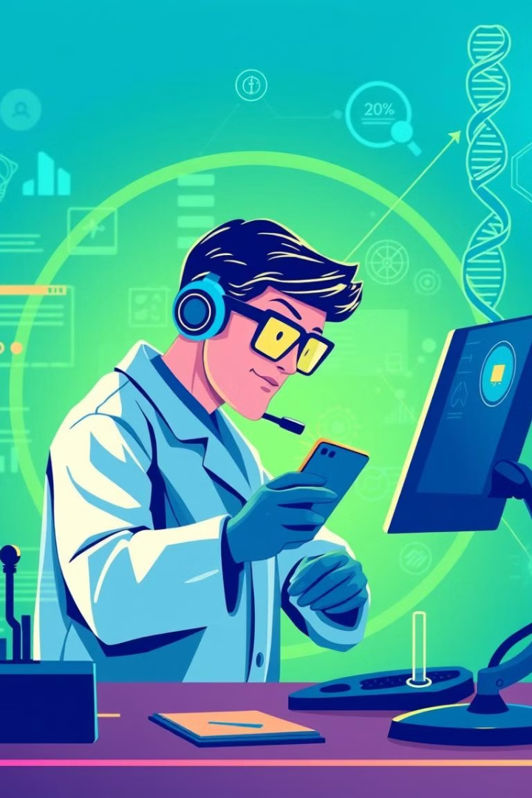
Precision Diagnostics, Therapeutics, and Medicine
1M
100K
Genome Sequencing
Drug Development
AI helps analyze vast genomic datasets, leading to personalized diagnoses and treatments.
AI accelerates drug discovery and development, leading to more effective and targeted therapies.
1B
Healthcare Optimization
AI improves healthcare efficiency, reduces costs, and enhances patient outcomes.

